Slide 1

PYTHON
Presented By:
Musrat Jahan
Software Engineer Intern
MetroBlue Tech Systems LTD
1
29 JANUARY 2026

Slide 2
I ACKNOWLEDGE THE LARRAKIA PEOPLE AS THE TRADITIONAL OWNERS OF THE LAND ON WHICH WE MEET TODAY. I PAY MY RESPECTS TO ELDERS PAST, PRESENT AND EMERGING, AND EXTEND THAT RESPECT TO ALL ABORIGINAL AND TORRES STRAIT ISLANDER PEOPLES.

Slide 3
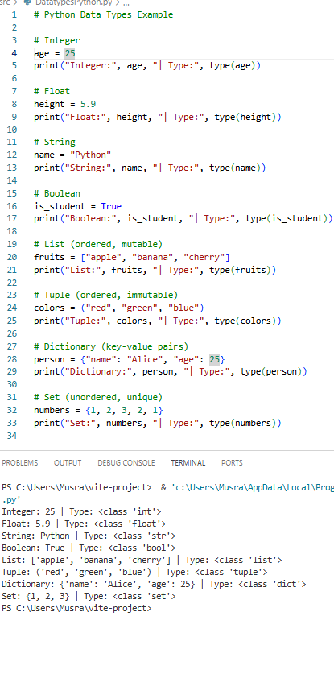
PYTHON DATA TYPE
EVERY VARIABLE IN PYTHON HAS A DATA TYPE
  INT → INTEGER NUMBERS (10, -5, 0)
  FLOAT → DECIMAL NUMBERS (3.14, 0.5)
  STR → STRINGS (‘NAME’, 'MUSRAT’)
  BOOL → BOOLEAN (TRUE, FALSE)
  LIST → ORDERED, MUTABLE [1,2,3]
  TUPLE → ORDERED, IMMUTABLE (1,2,3)
  DICT → KEY-VALUE PAIRS {"NAME":"ALICE", "AGE":25}
  SET → UNORDERED, UNIQUE {1,2,3}
2
PRESENTED BY: HARPER RUSSO

Slide 4
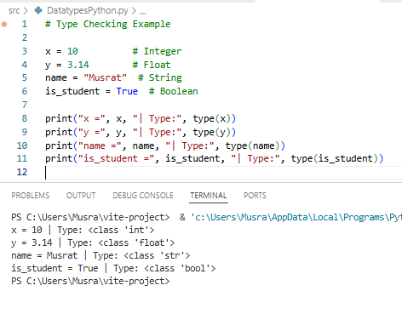
CREATIVE BRIEF
TYPE FUNCTION
TYPE() FUNCTION IS USED TO CHECK THE DATA TYPE OF A VARIABLE.
TYPE(VARIABLE_NAME)
TYPE(X)
2
PRESENTED BY: HARPER RUSSO

Slide 5
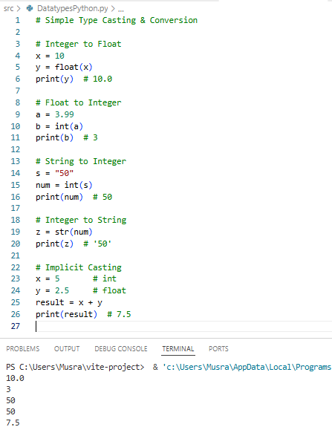
TYPE CASTING & CONVERSION
TYPE CASTING IS THE PROCESS OF CONVERTING A VARIABLE FROM ONE DATA TYPE TO ANOTHER.
  INT → FLOAT ; FLOAT(10) → 10.0
  FLOAT → INT; INT(3.99) → 3
  STRING → INT; INT("50") → 50
  INT → STRING ; STR(50) → "50"
2

Slide 6
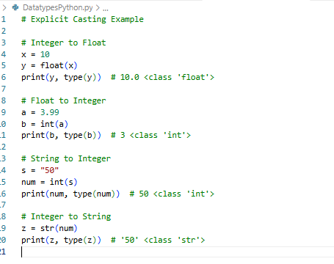
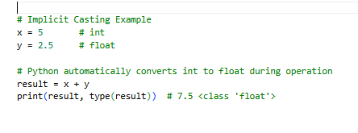
EXPLICIT &.
IMPLICIT CASTING
  Explicit casting → Convert manually using int(), float(), str(), bool().
  Implicit casting → Python converts automatically when different types are used in an operation.
3

Slide 7
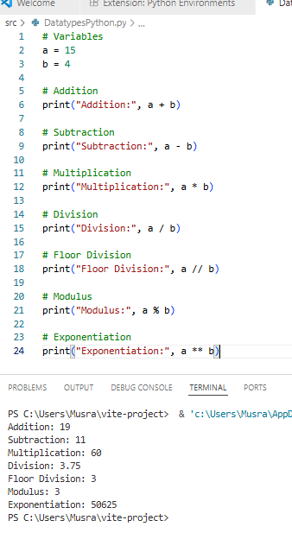
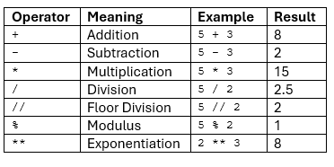
ARITHMETIC OPERATORS
PYTHON ARITHMETICS OPERATORS ARE USED TO PERFORM BASIC MATHEMATICAL OPERATIONS LIKE ADDITION, SUBTRACTION, MULTIPLICATION AND DIVISION.
2

Slide 8
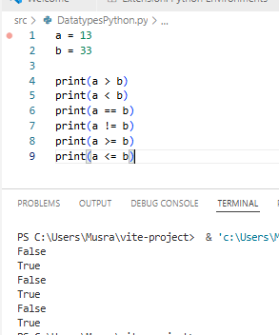
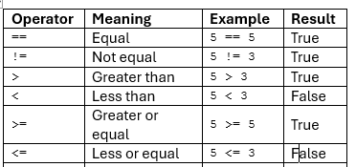
COMPARISON OPERATORS
COMPARISON OPERATORS COMPARES VALUES. IT EITHER RETURNS TRUE OR FALSE ACCORDING TO THE CONDITION.
2

Slide 9
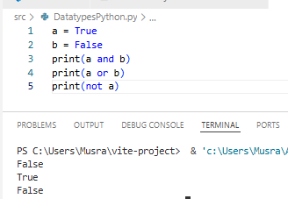
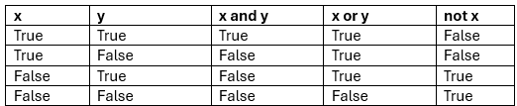
LOGICAL OPERATORS
PERFORM LOGICAL AND, LOGICAL OR AND LOGICAL NOT OPERATIONS. IT IS USED TO COMBINE CONDITIONAL STATEMENTS.
  THE PRECEDENCE OF LOGICAL OPERATORS IN PYTHON IS AS FOLLOWS:
  LOGICAL AND
  LOGICAL OR
  LOGICAL NOT
2

Slide 10
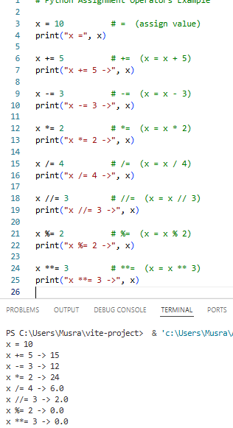
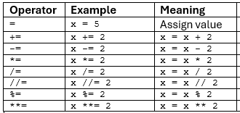
ASSIGNMENT OPERATORS
ASSIGNMENT OPERATORS ARE USED TO ASSIGN VALUES TO THE VARIABLES. THIS OPERATOR IS USED TO ASSIGN THE VALUE OF THE RIGHT SIDE OF THE EXPRESSION TO THE LEFT SIDE OPERAND.
2

Slide 11
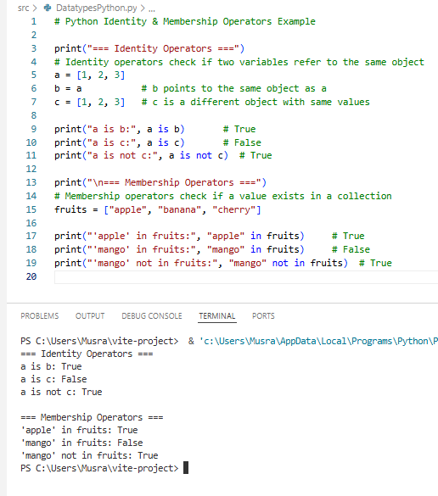
IDEntity and membership OPERATORS
IN PYTHON, MEMBERSHIP AND IDENTITY OPERATORS HELP US CHECK RELATIONSHIPS BETWEEN VALUES AND OBJECTS.
  IDENTITY OPERATORS (IS, IS NOT) → CHECK IF TWO VARIABLES REFER TO THE SAME OBJECT IN MEMORY.
  MEMBERSHIP OPERATORS (IN, NOT IN) → CHECK IF A VALUE EXISTS IN A LIST, TUPLE, SET, OR STRING.
2

Slide 12


